Slide 1
Line of best fit and correlation

Slide 2
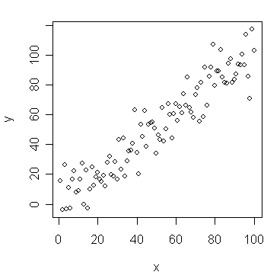
The Line of Best Fit
When there is a connection between two sets of data, we can draw a line of best fit.
The line of best fit shows the general trend of the data.
You can draw the line wherever you think it fits best..
...but some lines are better than others!

Slide 3
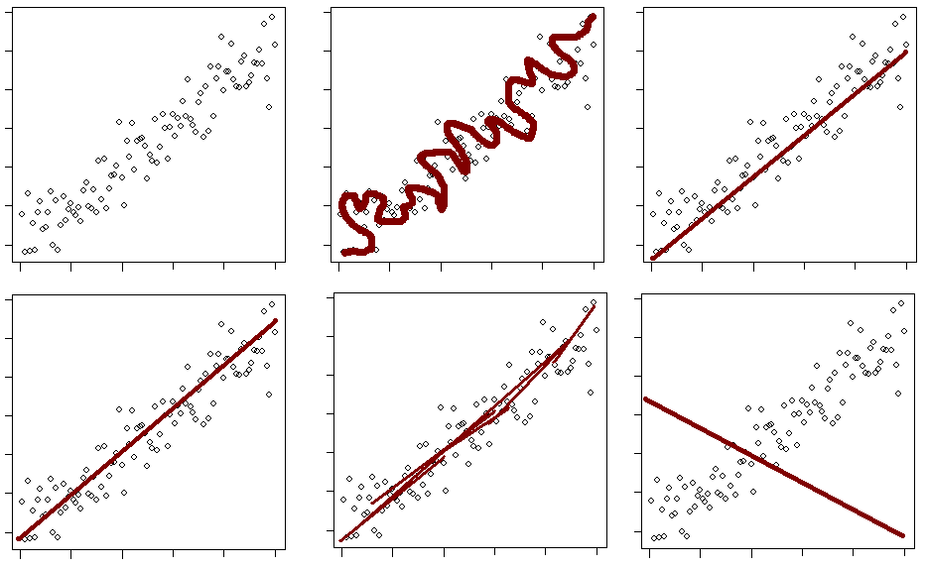
A line of best fit by eye is drawn through the scatterplot so that an equal number of points lie on either side of the line and are approximately the same distance from the line.

Slide 4
What would you expect to happen?
Look at the situations below and describe what you think might happen in each case:
1. The sales of ice creams as the temperature rises during the summer.
2. The value of a mobile phone as it gets older.
3. The amount you'll get in a maths test the further you live from school.

Slide 5
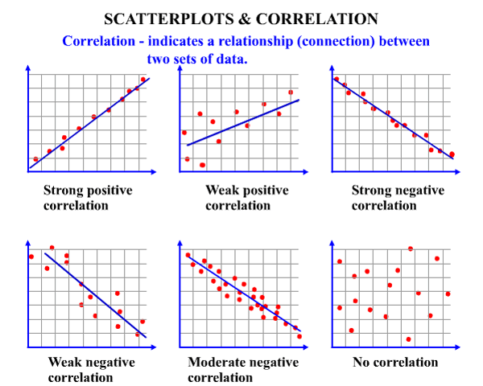
What do scatter graphs tell us?
There are basically 3 types of correlation:
Positive, Negative and No Correlation
The more in line the points, the stronger the correlation.

Slide 6
What do you think the correlation might be in these situations?
1. The sales of ice creams as the temperature rises during the summer.
2. The value of a mobile phone as it gets older.
3. The amount you'll get in a maths test the further you live from school.

Slide 7
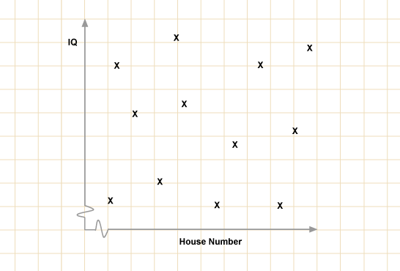
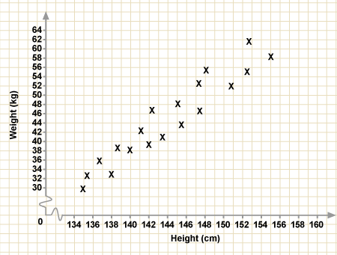
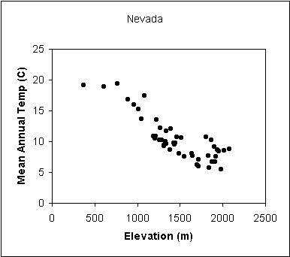
Describe the correlation of these scatter graphs:

Slide 8
Correlation vs Causation
Correlation occurs when 2 sets of data show a trend. A positive correlation means that when one thing goes up, the other goes too. A negative correlation when one goes up, the other goes down.
positive correlation
negative correlation
Causation, on the other hand, means that one thing will cause the other.
For example, when you exercise the amount of calories you are burning per minute will go up, as the former is causing the latter. Just because there is correlation, does not mean one event causes the other.

Slide 9
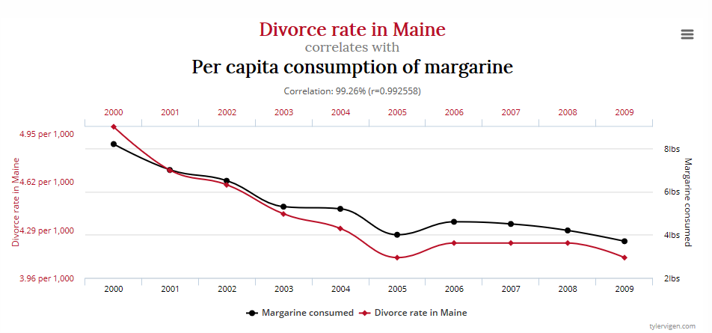
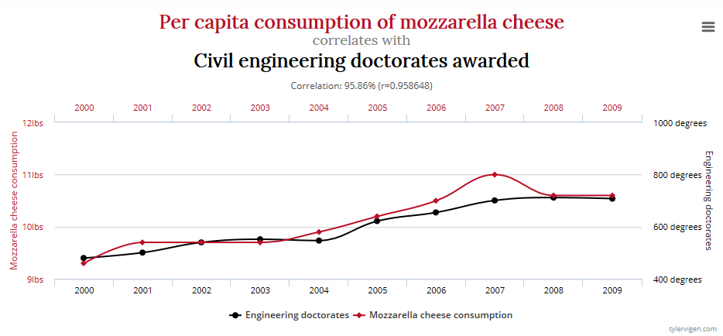
While these 2 graphs show correlation, the 2 events in each do not cause each other

Slide 10
Draw a scatter graph of this information and describe the correlation:
Student | A | B | C | D | E | F | G | H
Maths mark | 56 | 73 | 51 | 62 | 24 | 67 | 94 | 35
Art mark | 54 | 43 | 47 | 44 | 82 | 31 | 18 | 87
100
90
80
70
60
Art mark
50
40
30
20
10
0
10
20
30
40
50
60
70
80
90
100
Maths mark

Slide 11
Draw a scatter graph of this information and describe the correlation:
Student | A | B | C | D | E | F | G | H
Maths mark | 56 | 73 | 51 | 62 | 24 | 67 | 94 | 35
Art mark | 54 | 43 | 47 | 44 | 82 | 31 | 18 | 87
100
90
80
70
Correlation:
Negative(Moderate)
60
Art mark
50
40
Is this causation or correlation?
30
20
10
0
10
20
30
40
50
60
70
80
90
100
Maths mark

